Slide 1
CM3025 - Virtual Reality
By David Della Rossa
Notes:
This is a project for the Virtual Reality course at Computer Science degree, University of London

Slide 2
Simon plays VR
Game mechanics similar to Simon says classic game
Player is in a round room
A number of display panels are set on the walls of the round room
Player has a console with a number of buttons in the same configuration as the wall’s display panels
Panels light up in a certain order and emit a sound
It can be used as a game or as a learning tool
Notes:
The project I’m proposing is about a Virtual-Reality based version of the classic game Simon Says, here called Simon Plays VR
It is a puzzle game where the player receives inputs as a sequence of sounds or light impulses and she has to reproduce those in the correct order in a given amount of time.
Imagine the player in the centre of a round room. All around, on the walls, there are areas like big coloured displays. These displays are initially off, but they will light up and emit sounds during the gameplay.
The player has a console in front of her, with a number of buttons which recall the same disposition and colours of the display panels on the wall. When the game starts, the display panels light up and emit a sound, in a sequence that the player has to reproduce, by clicking on the corresponding button in the console.
The disposition and shape of the panels around the player, whether the panels light-up, sound, or both, all create different possible configurations and usages...

Slide 3
As a game
Player has to reproduce the correct order through clicking the buttons in the console
The sequences to reproduce become more and more long and complex as the game proceeds
Difficulty varies based on the number of panels, the length of sequences, the time given to answer and whether lights and sounds are on or off.
Notes:
...As a game
It will proceed basically as described. More complex sequences will be proposed and the player will have to correctly reproduce the order.
The difficulty varies based on the number of panels, the length of the sequences, the time given to answer, whether sounds and lights are on or off.

Slide 4
As a learning tool
Panels on the wall are shaped as the black and white keys in a keyboard
Player has a reproduction of the same keyboard on her console
Keys can optionally be highlighted along with the sounds emitted
Notes are played, and the player has to press the right keys on her keyboard to reproduce the same notes.
Great tool for ear-training
Mode 1: reproduce single, or multiple notes at unison or arpeggios and let the player recognise the notes and play them on the console
Mode 2: play a chord and let the player recognise the type of chord. In this mode, the console will have a different configuration, letting the user select the chord type, instead of the single notes.
Notes:
As a learning tool...
Shaping and positioning the panels like black and white keys in a keyboard, and providing the player with a reproduction of the same keyboard in the console, the player would have to play on the keyboard the same sequence of notes shown on the big keyboard, as single notes, or as poly-chords.
Mode 1: reproduce single, or multiple notes as chords or arpeggios and let the player recognise the notes that make up the chords or arpeggios and play them on the console.
Mode 2: the game will propose a chord and let the player recognise the type of chord. In this mode, the console will have a different configuration, letting the user select the chord type, instead of the single notes that make it up.
This would be a great tool for ear-training courses.

Slide 5
As a therapy tool
It could be used as a rehabilitation tool to help people with temporary reversible sensory deficits
Recognise sound direction
Recognise different colours
Shape recognition
Exercise visual-motor coordination
Notes:
As a therapy tool
This game could also be helpful in rehabilitation therapies for people with temporary reversible sensory deficits, for instance by
Recognising sound direction
Recognising different colours
Shape recognition
Exercising visual-motor coordination

Slide 6
Scope of this project
In this project I will be implementing a scene where the player can use Simon Plays VR as a game, and optionally as a learning tool.
The use of Simon Plays VR as a therapy tool is left out of scope.
Notes:
In this project I will be implementing a scene where the player can use Simon Plays VR as a game.
Optionally, if time is enough, also a scene where the game is used as a learning tool.
The use of Simon Plays VR as a therapy tool is left out of scope.

Slide 7
The original Simon says… game
Simon says is a children's game, where on player takes the role of "Simon" and issues instructions to the other players, which should be followed only when prefaced with the phrase "Simon says".
Players are eliminated from the game by either following instructions that are not immediately preceded by the phrase, or by failing to follow an instruction which does include the phrase "Simon says".
It is the ability to distinguish between genuine and fake commands, rather than physical ability, that usually matters in the game.
From Simon says on Wikipedia
Notes:
Simon says is a children's game, where one player takes the role of "Simon" and issues instructions to the other players, which should be followed only when prefaced with the phrase "Simon says".
Players are eliminated from the game by either following instructions that are not immediately preceded by the phrase, or by failing to follow an instruction which does include the phrase "Simon says".
It is the ability to distinguish between genuine and fake commands, rather than physical ability, that usually matters in the game.

Slide 8
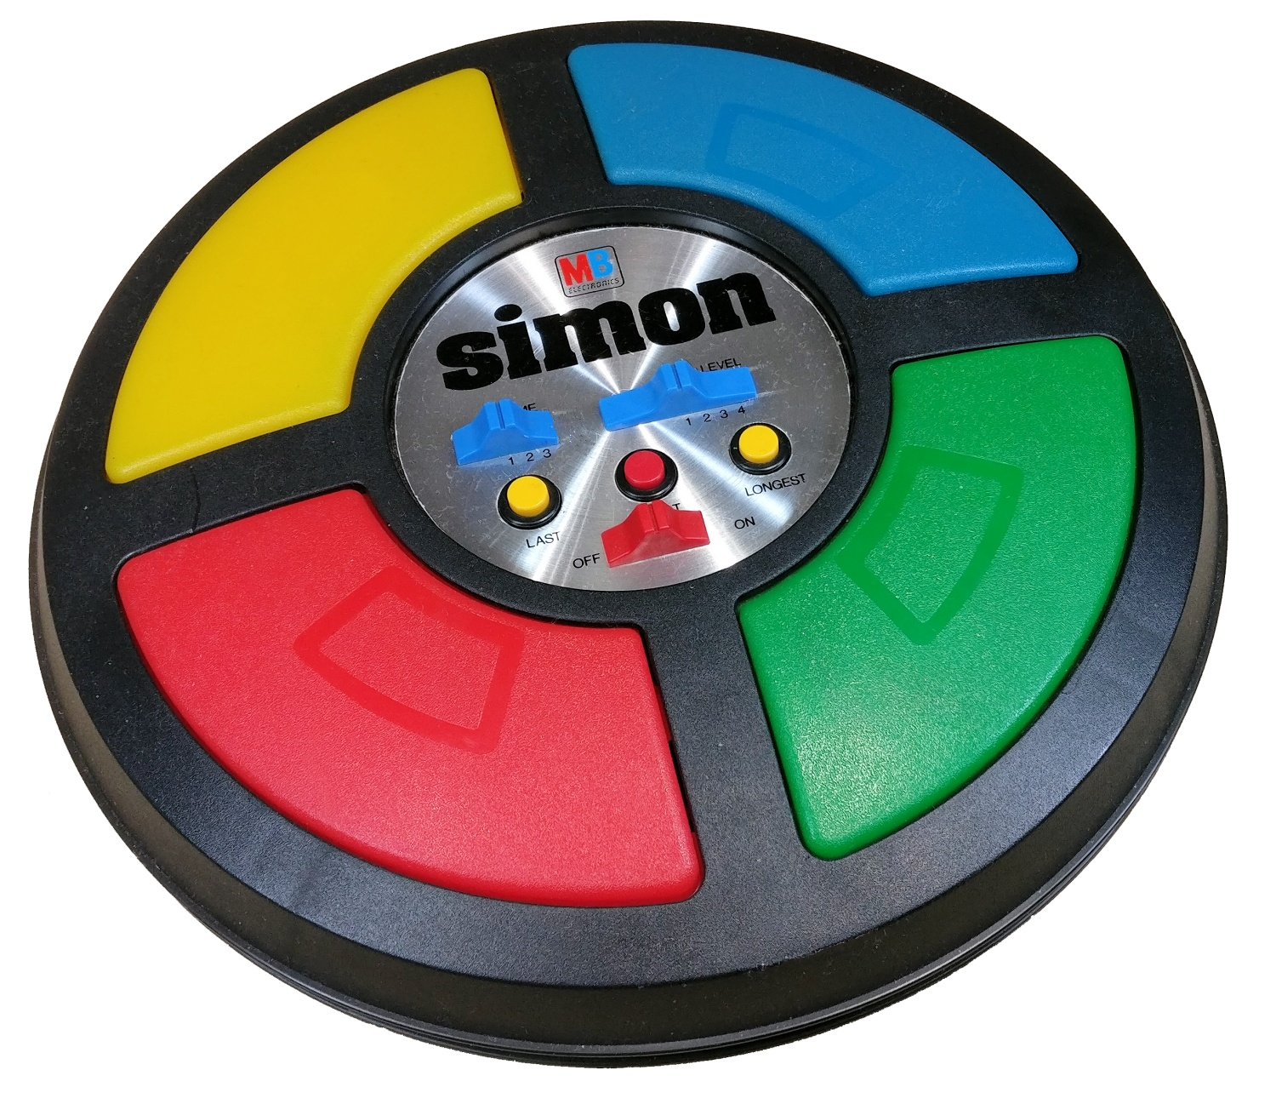
Simon electronic game
The electronic game Simon is named for Simon Says. Instead of having to listen to the presence of the instruction phrase, the player has to repeat a short sequence of button presses after demonstration by the device.
The original version was manufactured and distributed by Milton Bradley and later by Hasbro after it took over Milton Bradley.
The device creates a series of tones and lights and requires a user to repeat the sequence. If the user succeeds, the series becomes progressively longer and more complex. Once the user fails or the time limit runs out, the game is over.
Notes:
In the electronic version of Simon Says, simply named Simon,
the device creates a series of tones and lights and requires a user to repeat the sequence.
If the user succeeds, the series becomes progressively longer and more complex.
Once the user fails or the time limit runs out, the game is over.

Slide 9
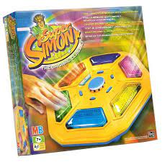
Super Simon
The original Super Simon was reinvented in the late 1990s as a hexagonal unit with six buttons.
Notes:
Many versions of the game have been issued in the last 30 years, and here are some of them:
Super simon, as a hexagonal unit with six buttons

Slide 10
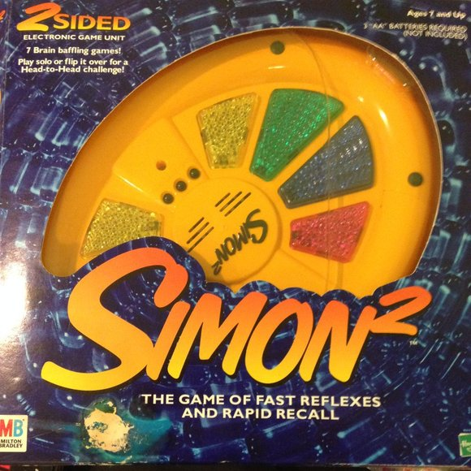
Simon Squared
2000 saw Simon Squared (or Simon2), a unit with the four traditional buttons on one side, and a set of eight smaller buttons on the other.
Notes:
Simon squared, having a unit with the four traditional buttons on one side, and a set of 8 smaller buttons on the other.

Slide 11
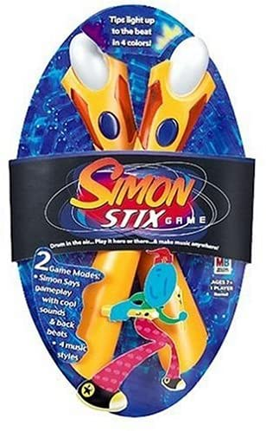
Simon Stix
In 2004, Hasbro released the Simon Stix. The game features two electronic sticks (modeled after drumsticks), an emphasis on the musical part of the game.
Notes:
Simon Stix features two electronic drumsticks, emphasizing on the musical part of the game

Slide 12
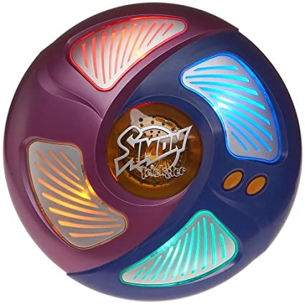
Simon Trickster
In 2005, Hasbro released Simon Trickster, which features four game modes:
Simon Classic mode plays up to 35 tones.
Simon Bounce is similar to "Simon Classic", but instead the colors of the lenses change.
Simon Surprise is one of the most difficult games in the unit. Every lens becomes the same color and the player has to memorize the location.
Simon Rewind requires the player to memorize the sequence backwards.
Notes:
Simon Trickster, featuring four different game modes

Slide 13
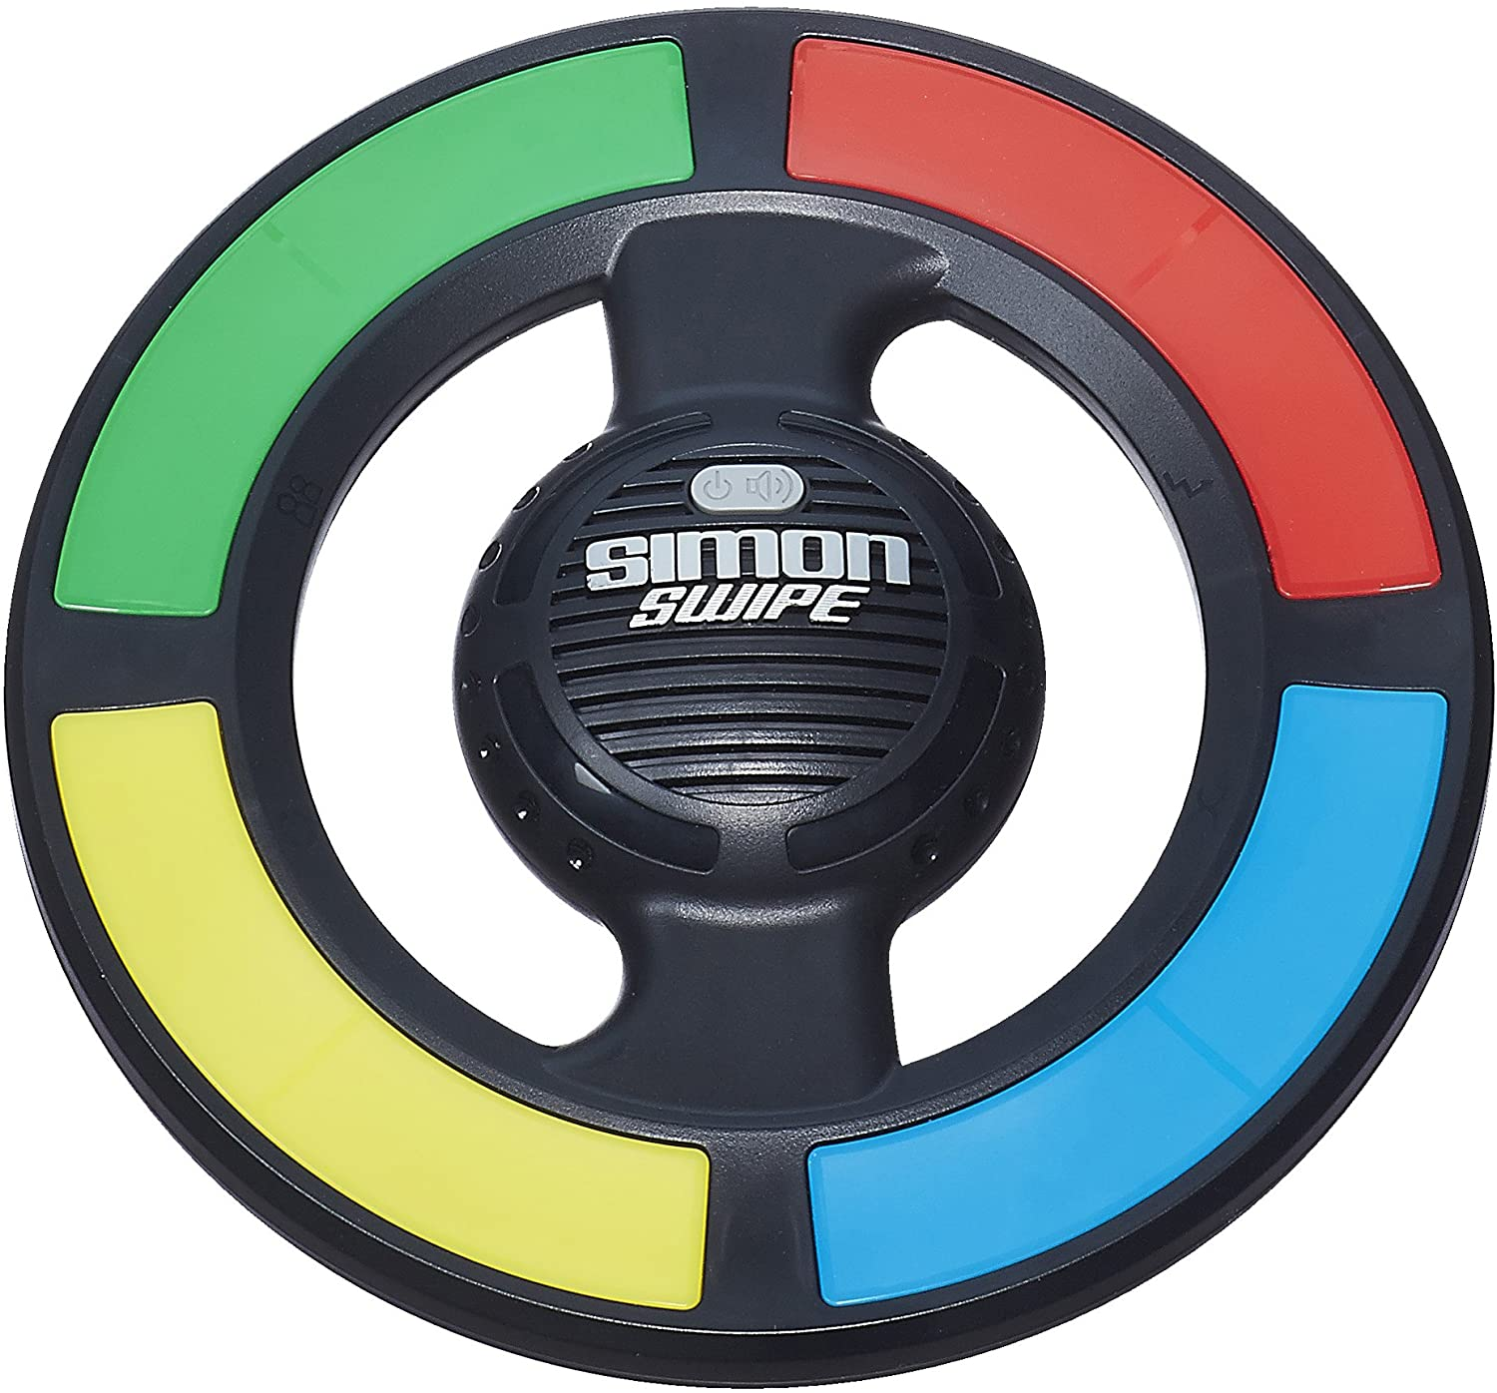
Simon Swipe
In 2013, Hasbro reinvented Simon once again with Simon Swipe. The game features four game modes, called
Levels (the main game),
Classic,
Party
Extreme.
The player has to go through all sixteen levels to beat the game.
Classic, Party and Extreme levels focus on one pattern getting longer and longer until the player is out.
Notes:
Simon Swipe, again featuring four game modes and a different look

Slide 14
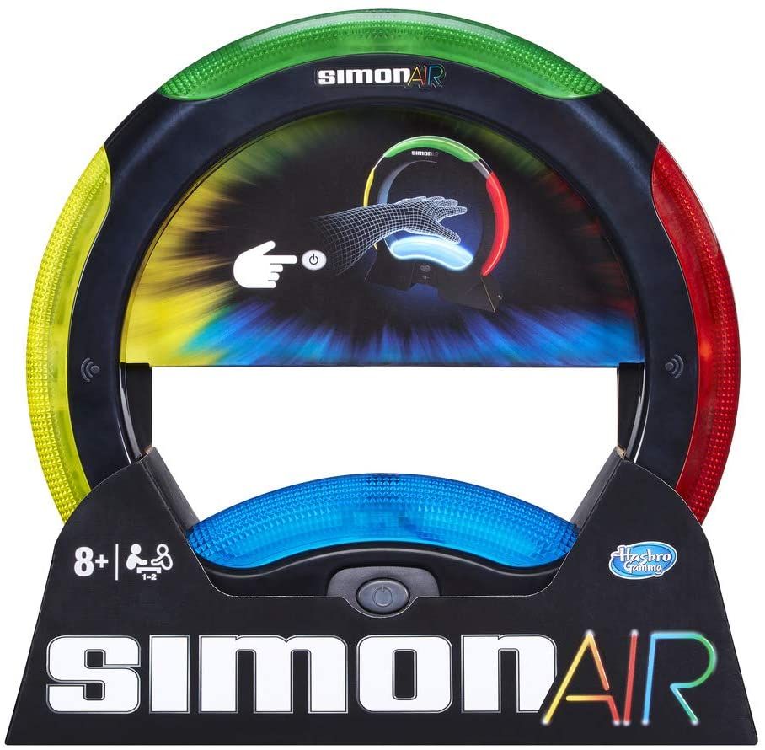
Simon Air
In 2016, Hasbro launched the follow-up to Simon Swipe with Simon Air.
This version of Simon uses motion sensors
Notes:
Simon Air, featuring motion sensors to detect hand position

Slide 15
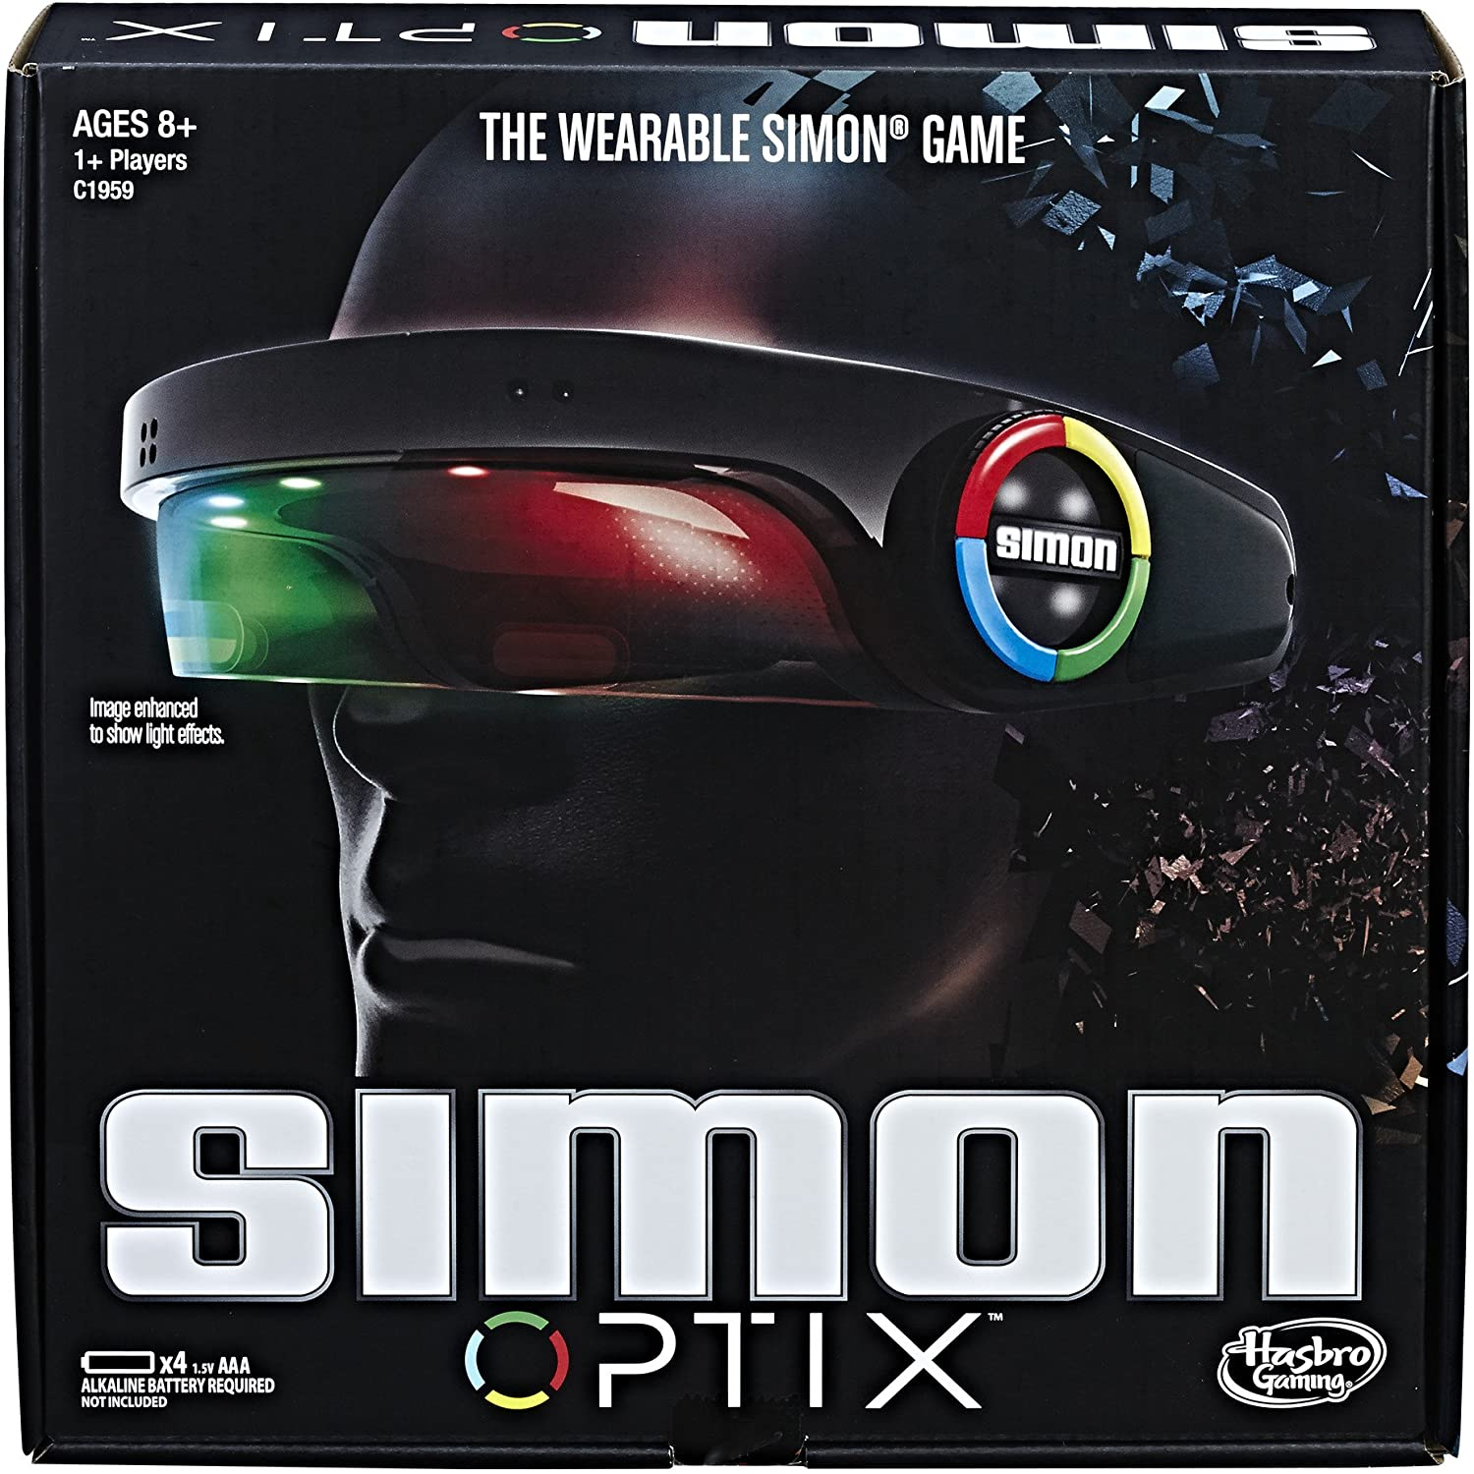
Simon Optix I
Although it looks like a modern XR-based interpretation of the Simon game, it's nothing like that.
This is just a wearable version of the classic electronic game Simon, just mounted over your head.
Notes:
Simon Optix
Although it looks like a modern XR-based interpretation of the Simon game, it's nothing like that.
This is just a wearable version of the classic game, just mounted over your head.

Slide 16
Simon Optix II
There is a coloured glass in front of your eyes and a sensor of movement that detects the position of your hands in front of the glass.
You see the colour pattern highlighted on the screen, which you mimic, swiping your hand in front of the screen. The sensor detects your hand and, if it matches, you score.
Considerations:
Fancy, led-based colourful wearable that resembles an XR headset like Microsoft Hololens
Two devices can communicate with each other via infrared, in a local multiplayer game.
Not a XR-based game as the shape would suggest
Simon Air already had motion detection
Notes:
In Simon Optix there is a coloured glass in front of your eyes and a sensor of movements that detects the position of your hands in front of the glass.
You see the colour pattern highlighted on the screen, which you mimic, swiping your hand in front of the screen. The sensor detects your hand and, if it matches, you score.
It is a fancy, led-based colourful wearable that resembles an XR headset like Microsoft Hololens, but it is not a XR-based game as the shape would suggest.
Two devices at close distance can communicate with each other via infrared, in a local multiplayer game, which is a nice addition.
Simon Air already had motion detection, so no innovation on this side

Slide 17
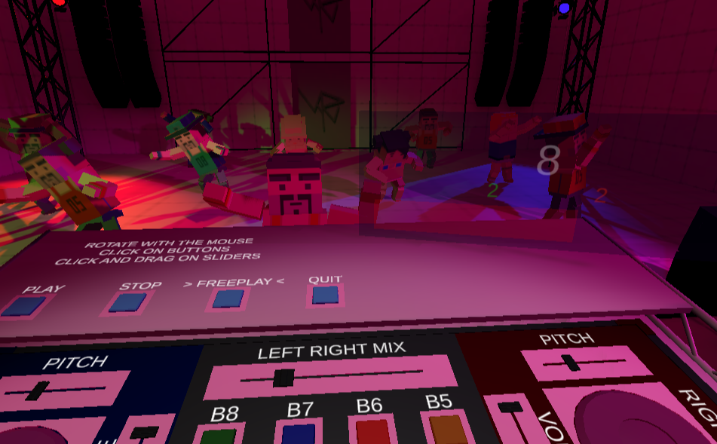
Simon DJ
Simon DJ is a rhythm VR game.
Player has to play the song following the steps and keep the party going.
Player can use the controller to activate the buttons and drag to move sliders and turntables.
Notes:
Simon DJ is a real Virtual reality game, found on itch.io.
Respect to the idea I have in mind, this is more focusing on the music, than on the puzzle-solving mechanics or the educational aspects.
Also, the scope of the game is limited to one single room and one single goal.

Slide 18
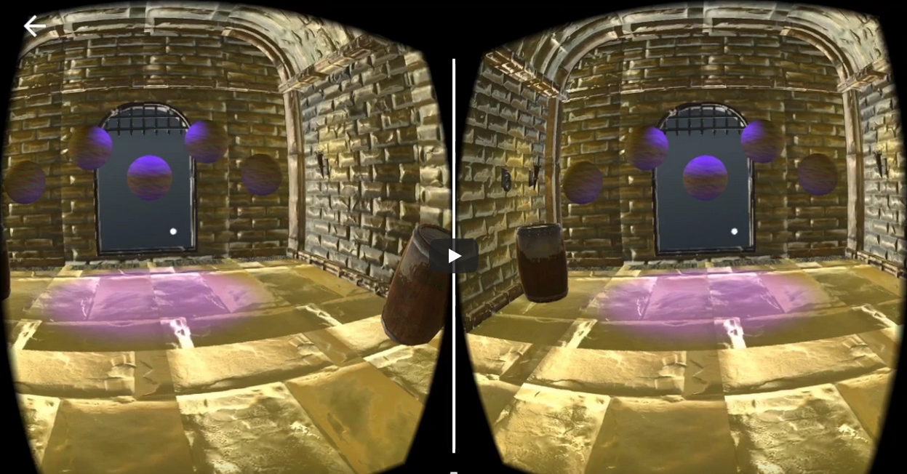
Simon Says VR I
This is a mobile VR version of Simon Says game for Google Cardboard.
It presents a sequence of rooms in a dungeon. Each room has a number of orbs aligned in front of the player.
These orbs light up in a certain order.
The player has to click on the orbs following the same sequence.
When she succeeds, she is transported in the next room.
University project made by James Requa
Notes:
Simon Says VR is a mobile VR version of Simon Says, designed for iPhone and Google Cardboard.

Slide 19
Simon Says VR II
Consideration:
Real VR game
Designed for iPhone with Google Cardboard
No hand controllers. Interaction with the game via the buttons on Google Cardboard
One mode of playing: emulating the classic Simon Plays game
Notes:
It focuses exclusively on the game experience, which is pretty much similar to classic Simon electronic games.
As a VR experience, this is limited by the fact that there is no hand controllers to interact with the virtual world, as this is done via the buttons offered by the Google Cardboard device.

Slide 20
Thank you for watching
Notes:
And this the end of this analysis and evaluation.
Thank you for watching

